Slide 1

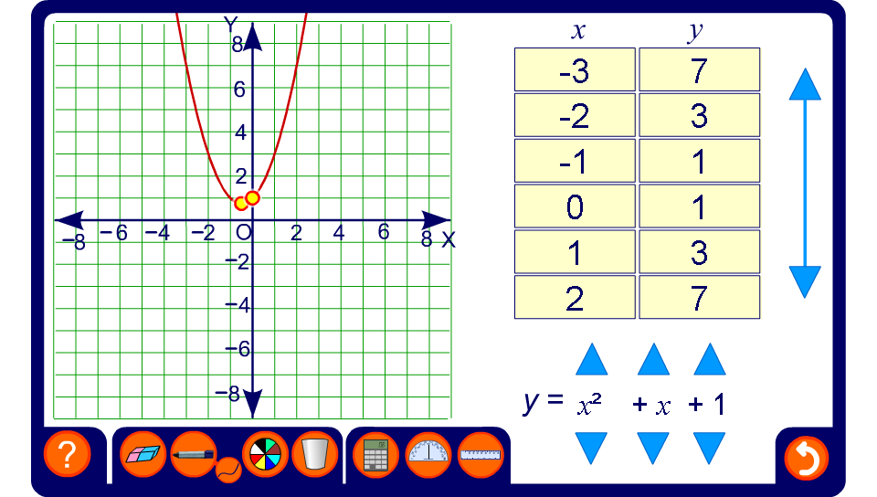


Exploring quadratic graphs
Notes:
Point out the basic features of the quadratic graph. Draw particular attention to its symmetry and to the fact that it will always have a maximum or minimum value.
Explore the effect of changing the coefficient of x². In particular, notice that if the coefficient of x² is is positive the curve has a minimum point and if it is negative it has a maximum point.
Changing the value of c translates the curve vertically. This is discussed in more detail in A9.6 Translating graphs.
The coordinates of the x- and y-intercepts and the maximum or minimum value can be revealed if required. Discuss how the values of these points can be found by putting x or y equal to 0 in the function and solving the corresponding equation.

